Slide 2
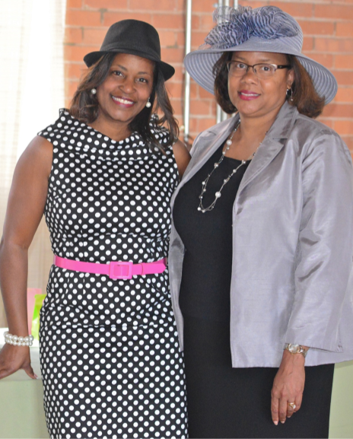

Slide 3
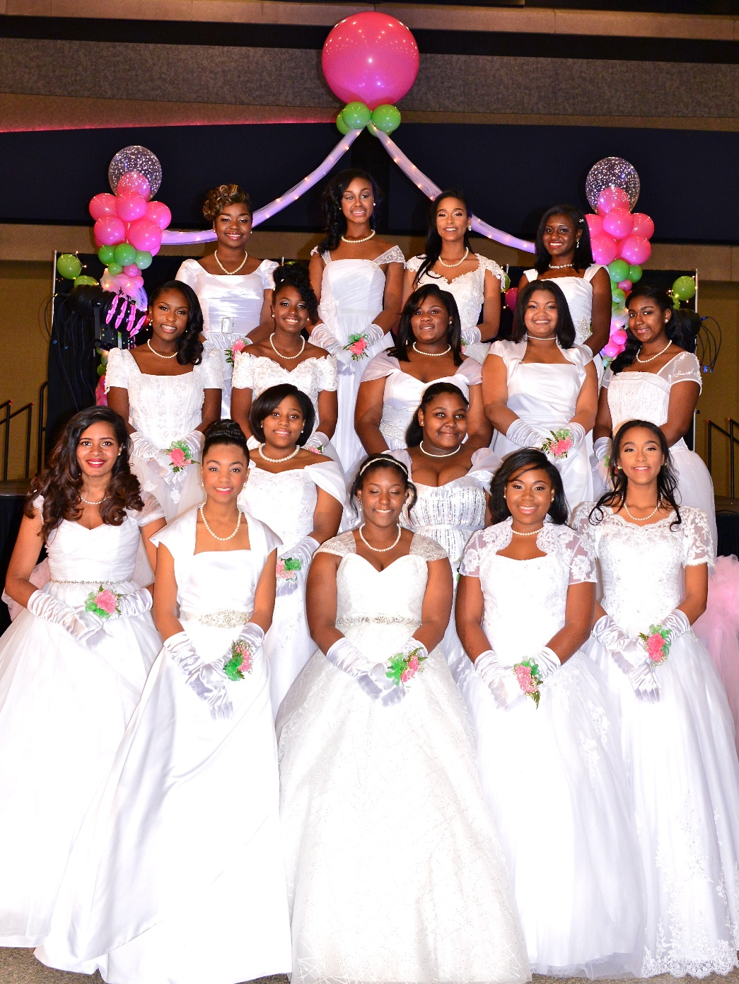
Debutante Pageant & Ball

Slide 4
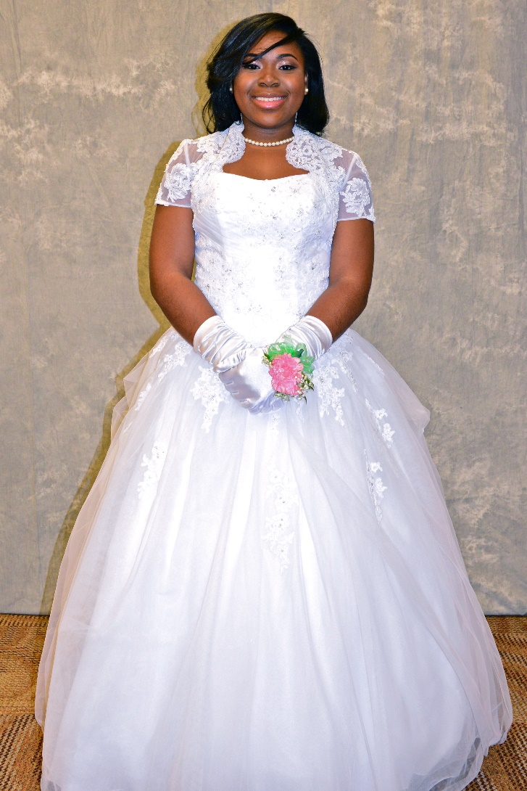
Rites of Passage & Debutante Ball
Janelle Benton

Slide 5
Rites of Passage & Debutante Ball
Iyanna Coleman

Slide 6
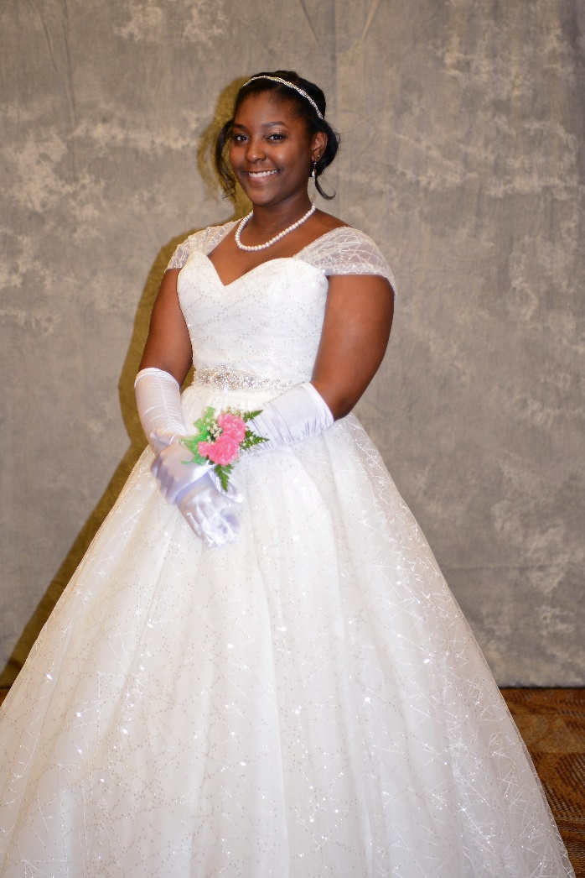
Rites of Passage & Debutante Ball
Jensen Daniels

Slide 7
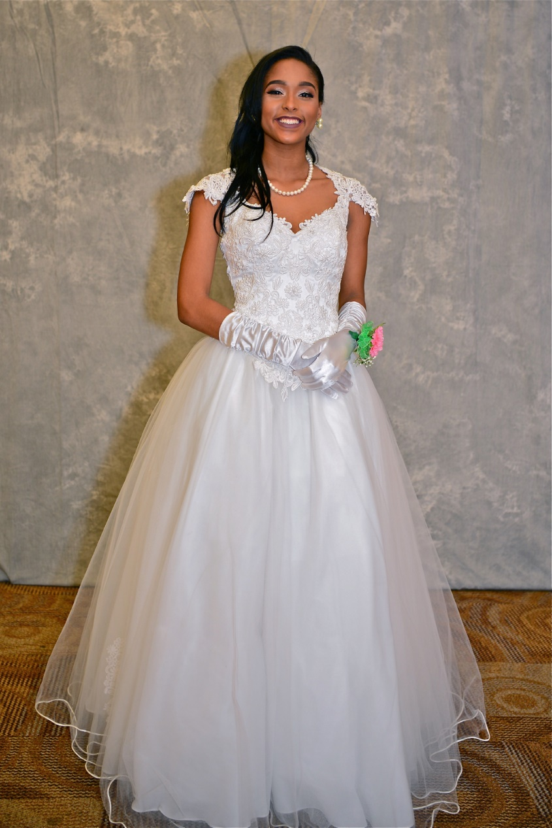
Rites of Passage & Debutante Ball
Kia Ellis

Slide 8
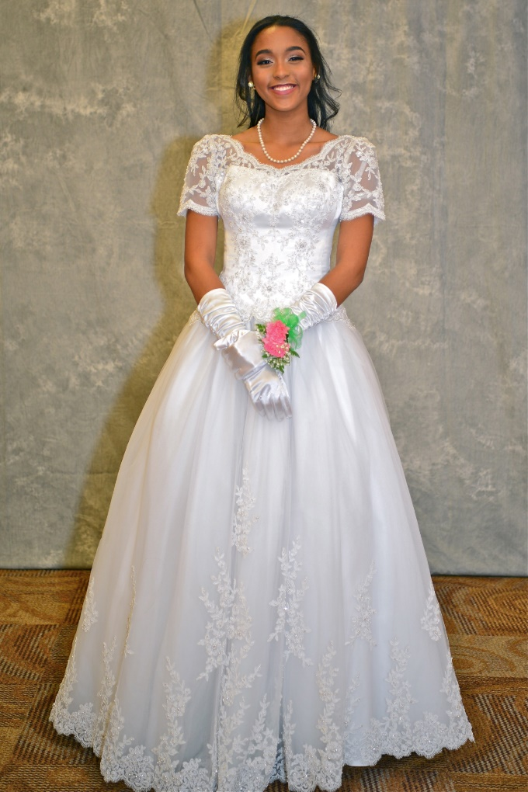
Rites of Passage & Debutante Ball
Nia Ellis

Slide 9
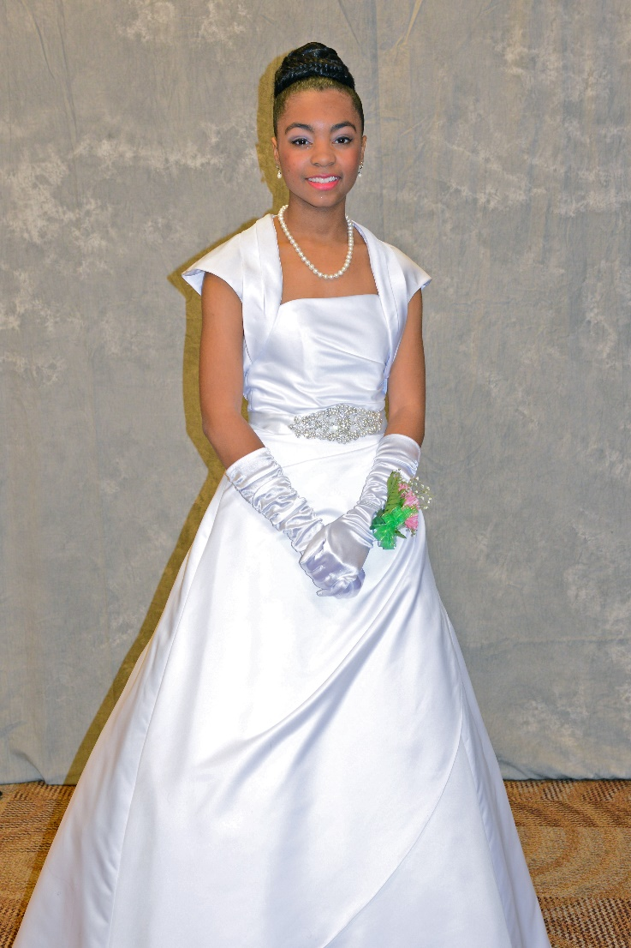
Rites of Passage & Debutante Ball
Courtney Harris

Slide 10
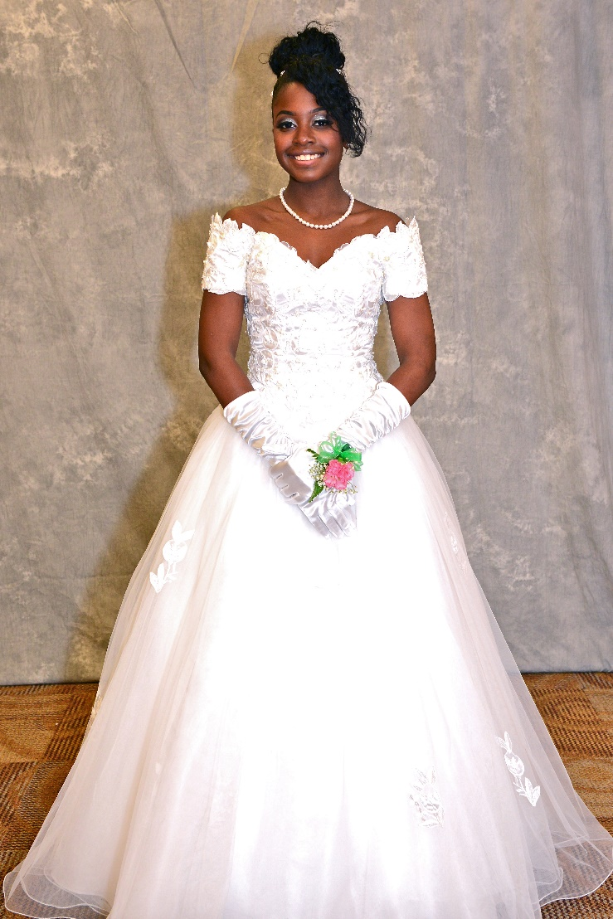
Rites of Passage & Debutante Ball
Ahmari Jenkins

Slide 11
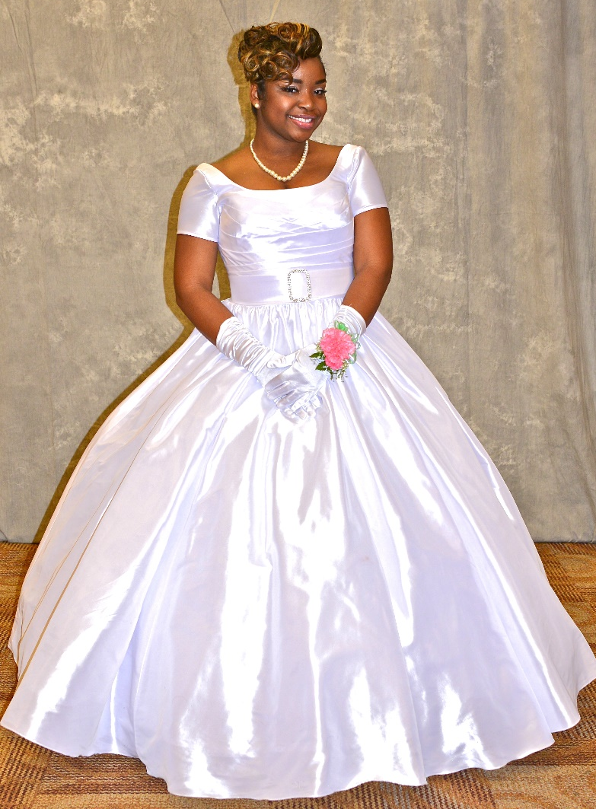
Rites of Passage & Debutante Ball
Dayonna Johnson

Slide 12
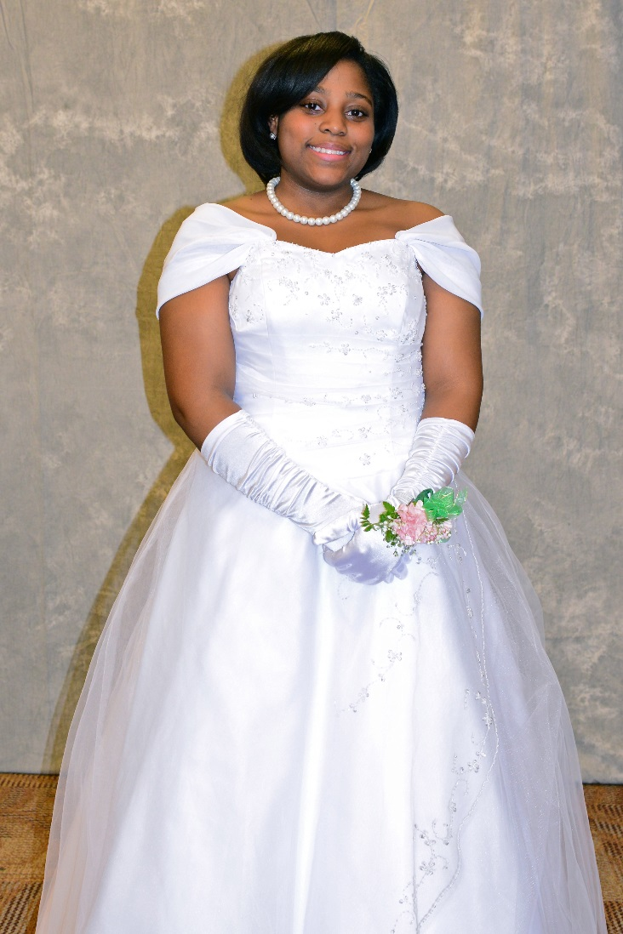
Rites of Passage & Debutante Ball
Danielle Lewis

Slide 13
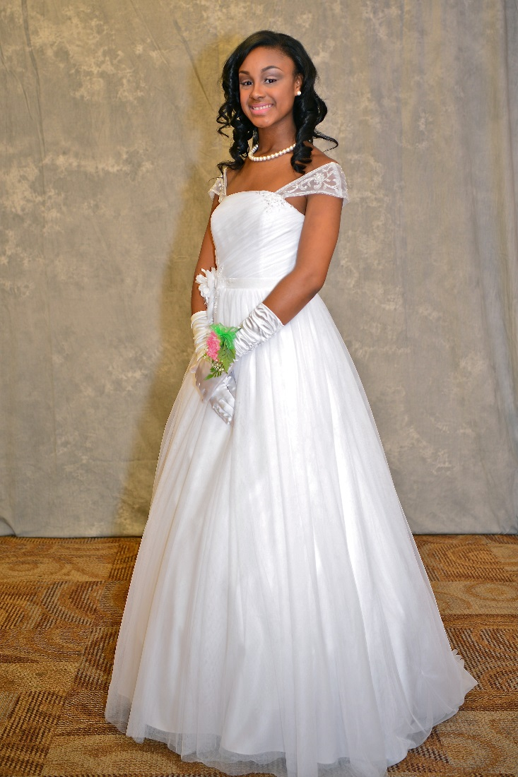
Rites of Passage & Debutante Ball
Kennedy McGriff

Slide 14
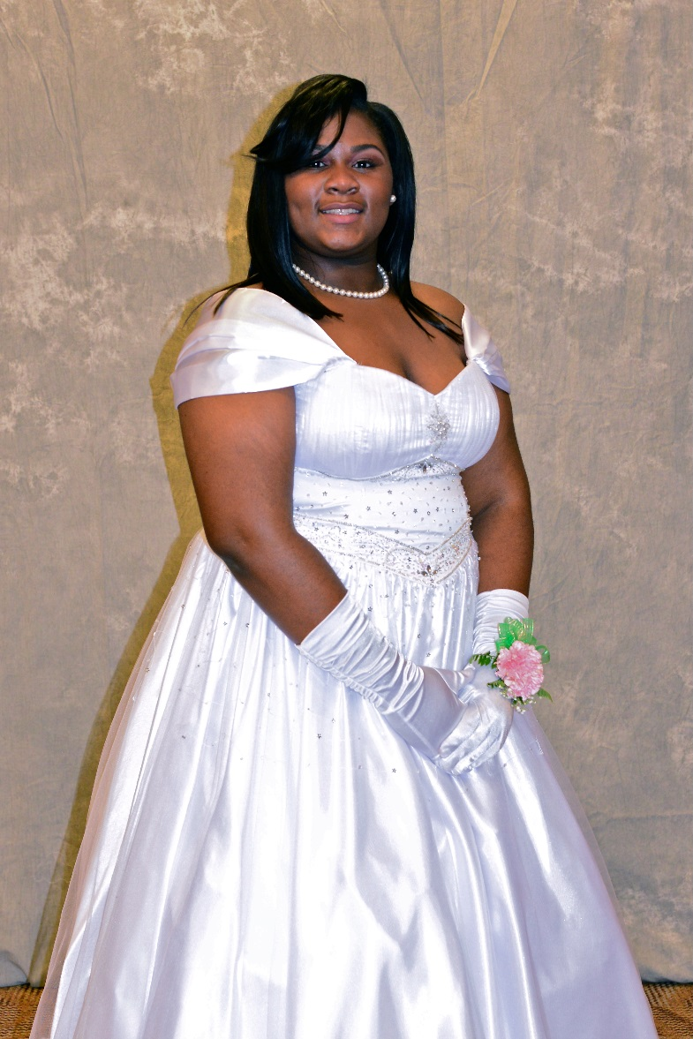
Rites of Passage & Debutante Ball
T’najah Meekes

Slide 15
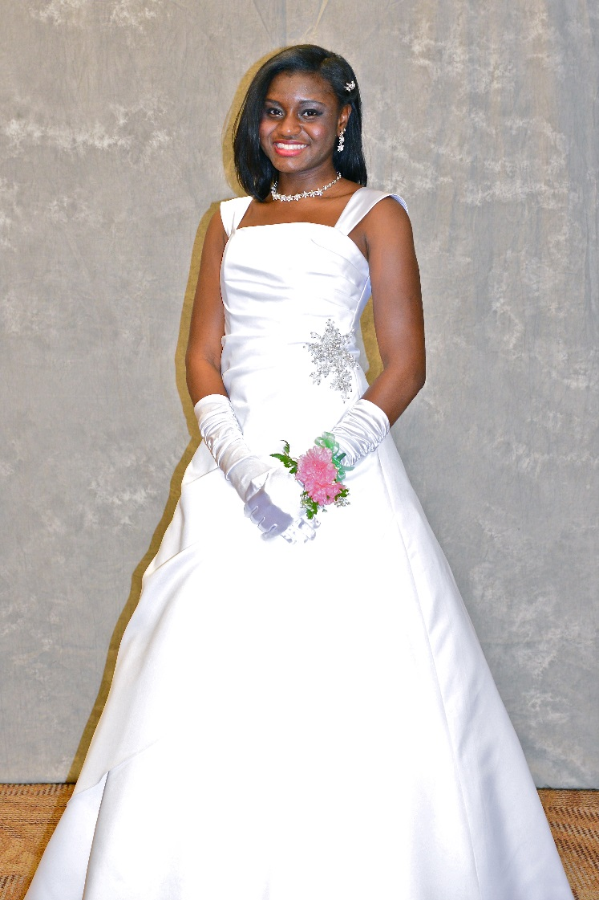
Rites of Passage & Debutante Ball
Daneya Moncrieffe

Slide 16
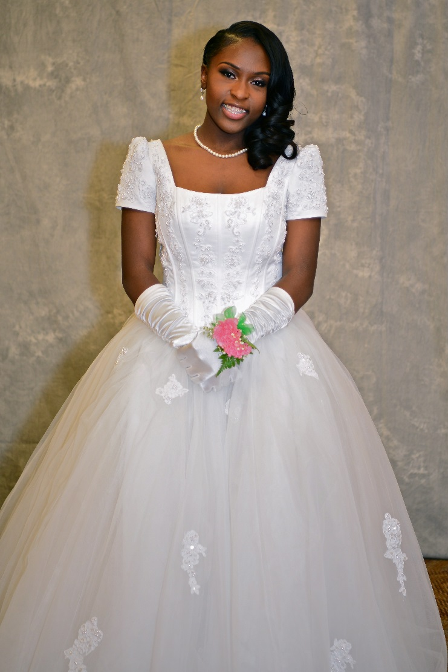
Rites of Passage & Debutante Ball
Gabrielle Outling

Slide 17
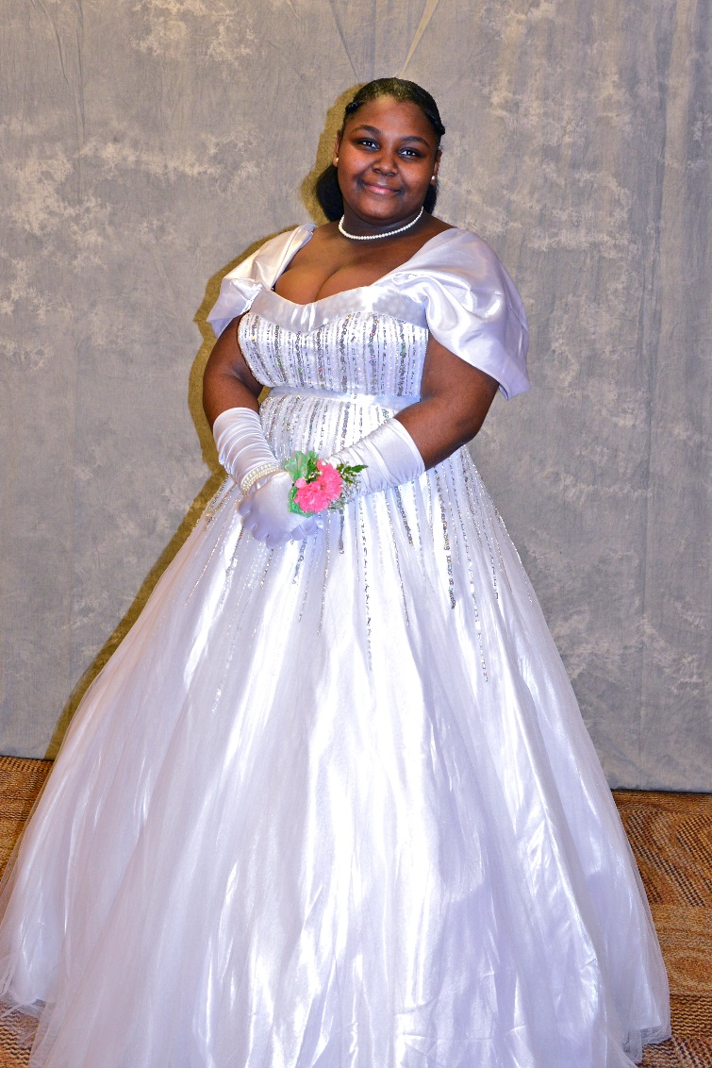
Rites of Passage & Debutante Ball
Leah Price

Slide 18
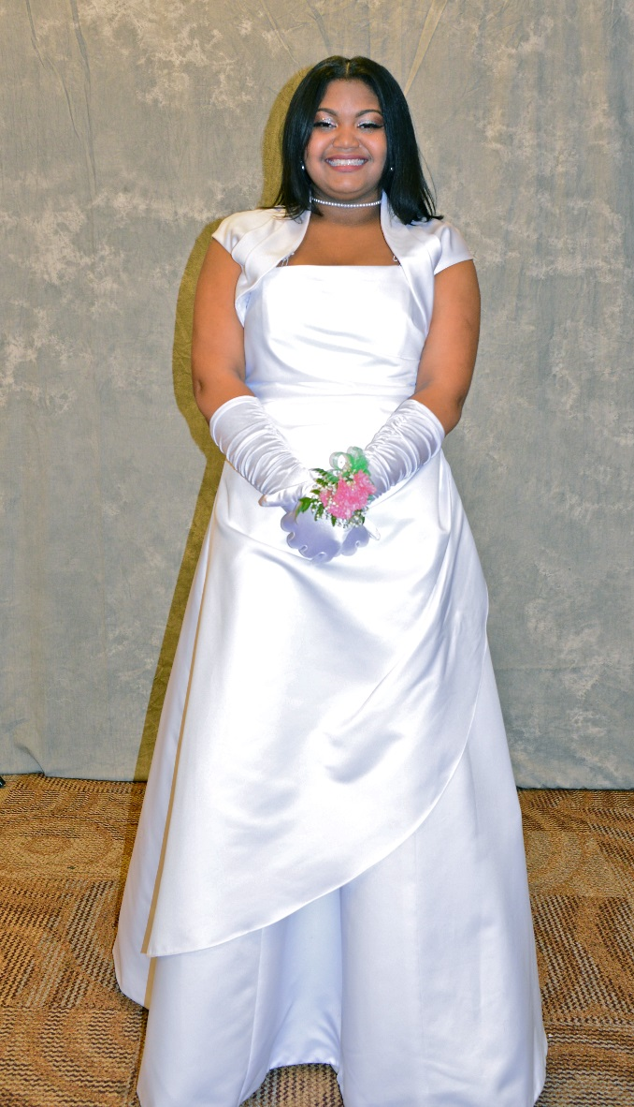
Rites of Passage & Debutante Ball
Lilithann Thompson

Slide 19
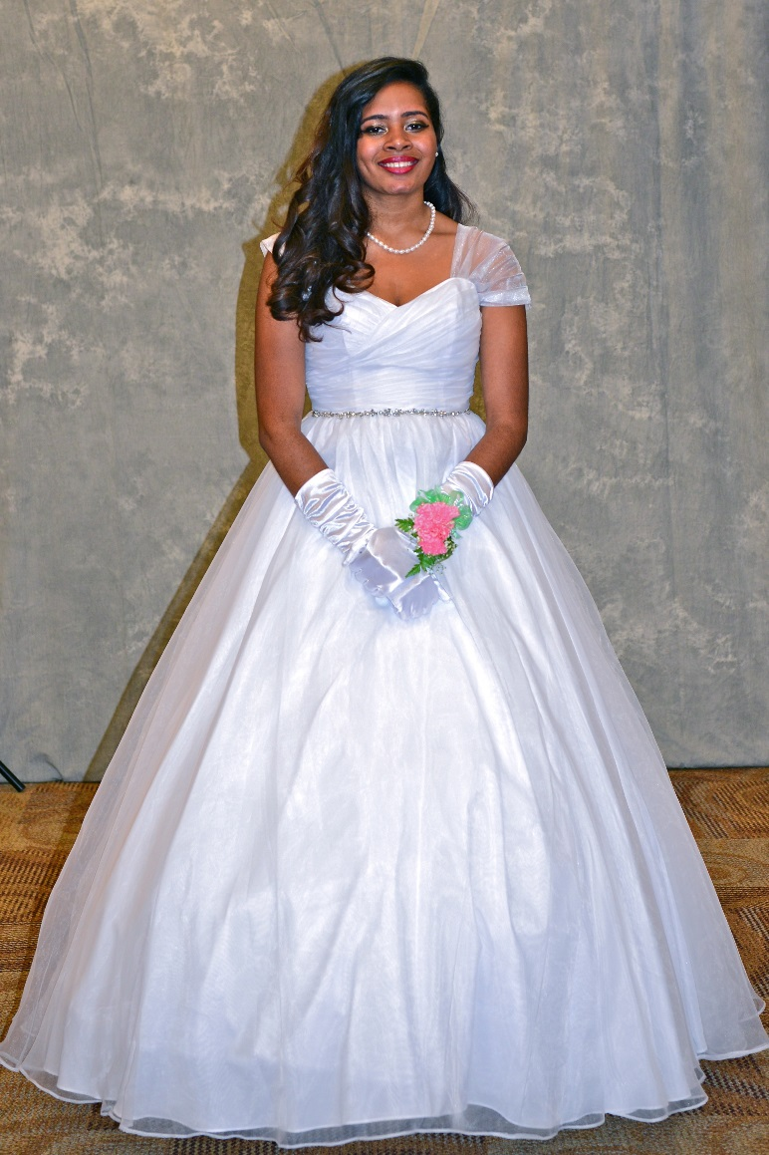
Rites of Passage & Debutante Ball
Nyasia Wilson

Slide 20
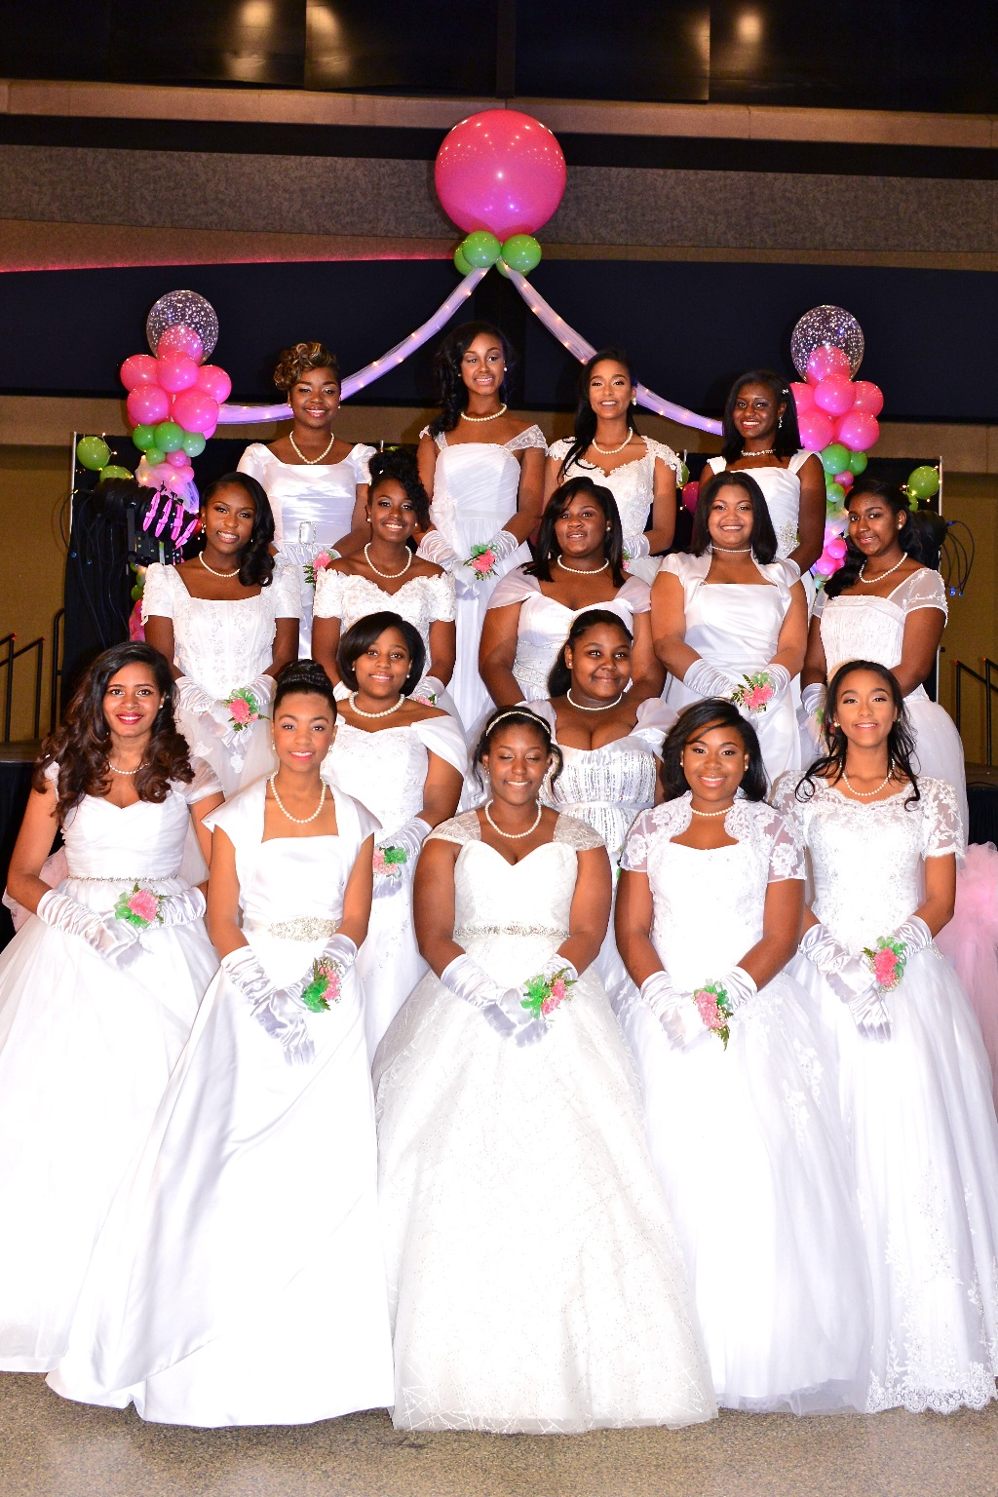
Debutante Pageant & Ball

Slide 21
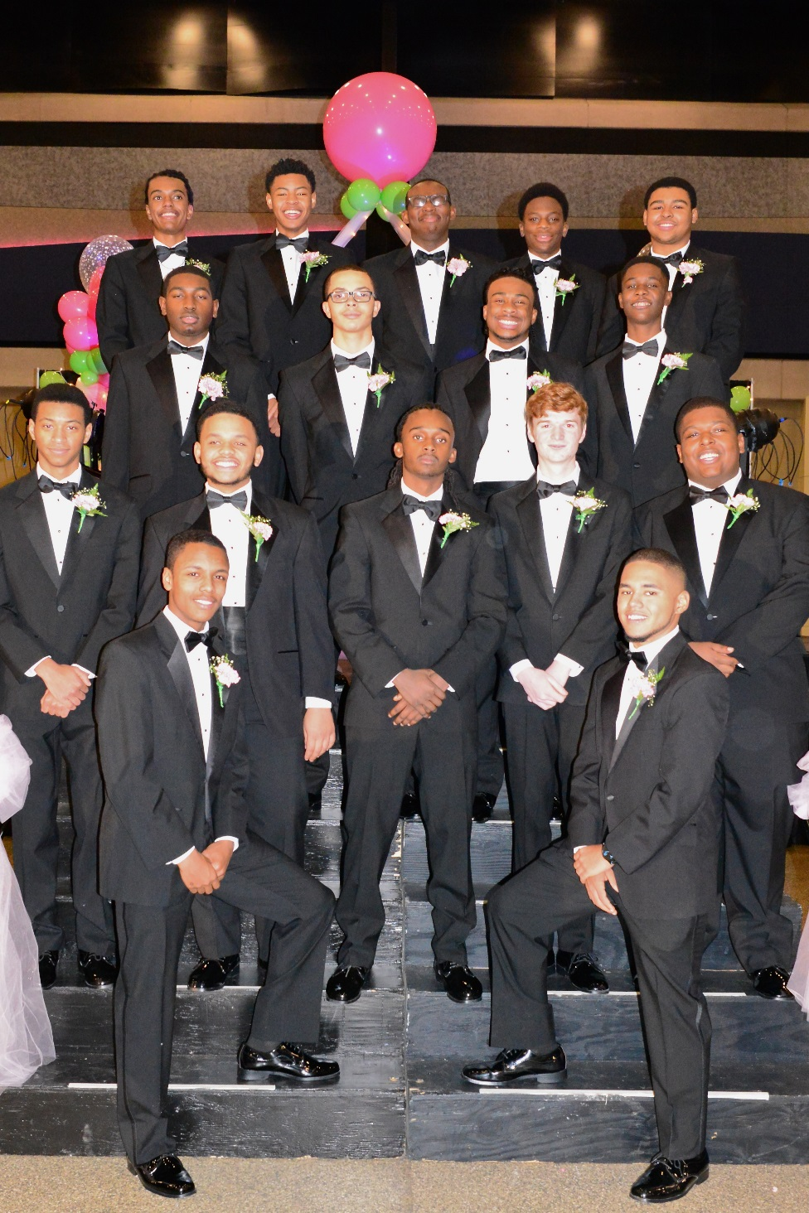
Debutante Pageant & Ball

Slide 22
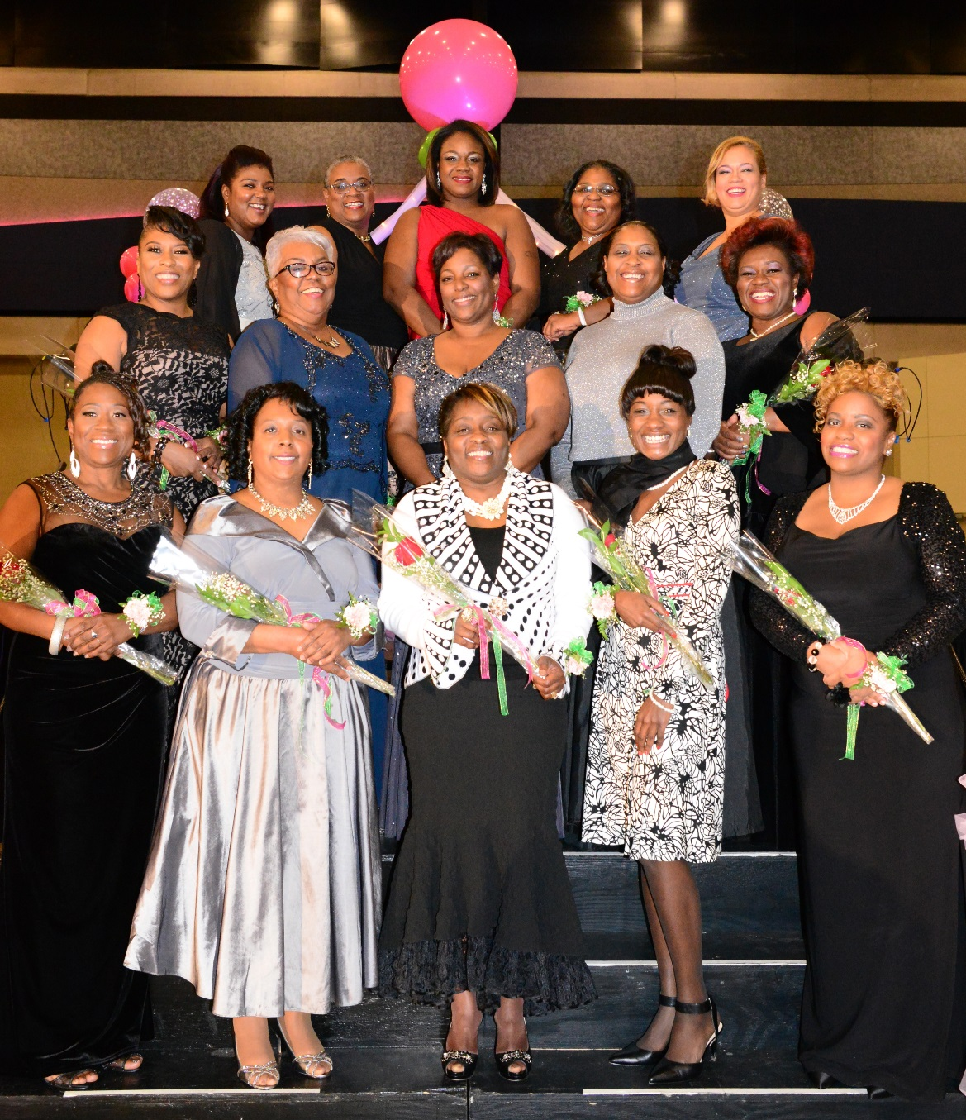
Debutante Pageant & Ball

Slide 23
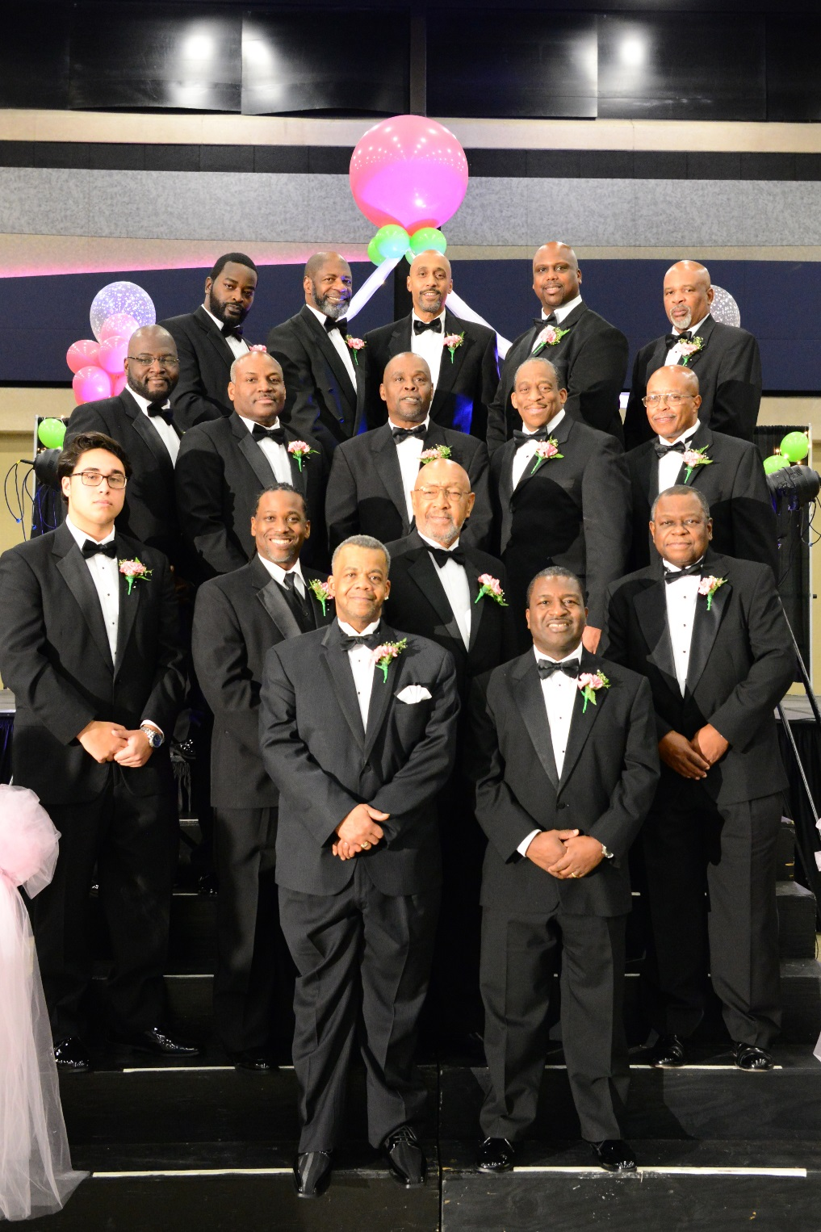
Debutante Pageant & Ball

Slide 24
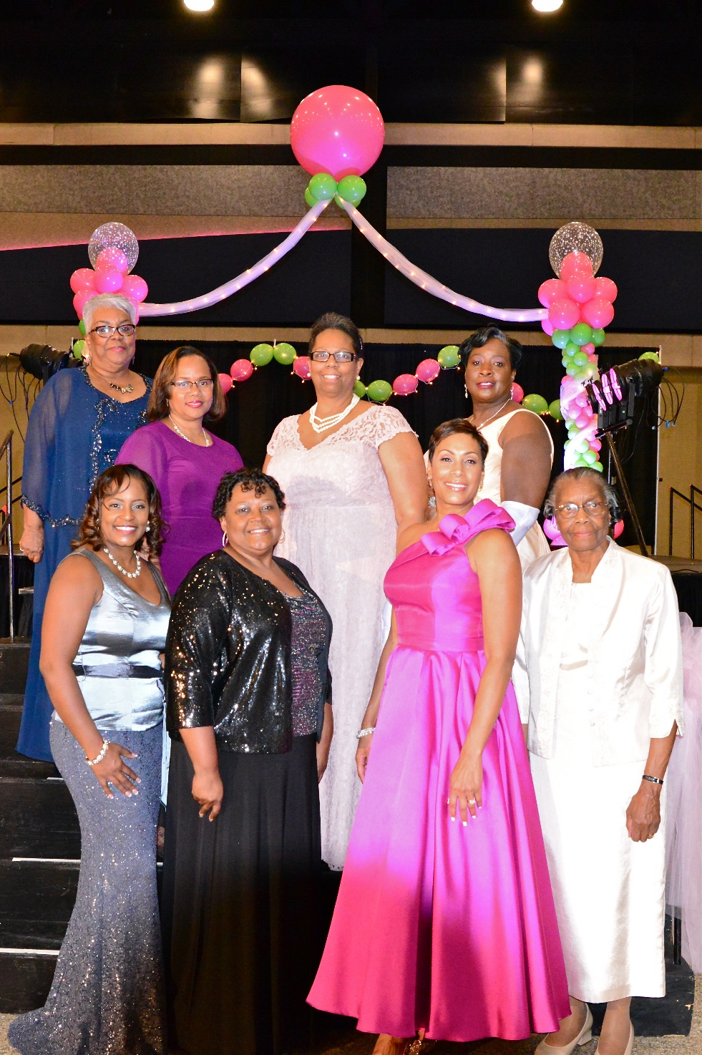
Debutante Pageant & Ball

Slide 25
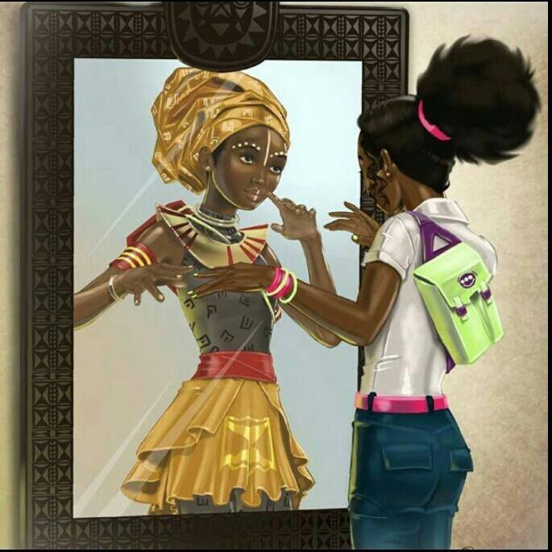
Debutante Rites of Passage

Slide 26
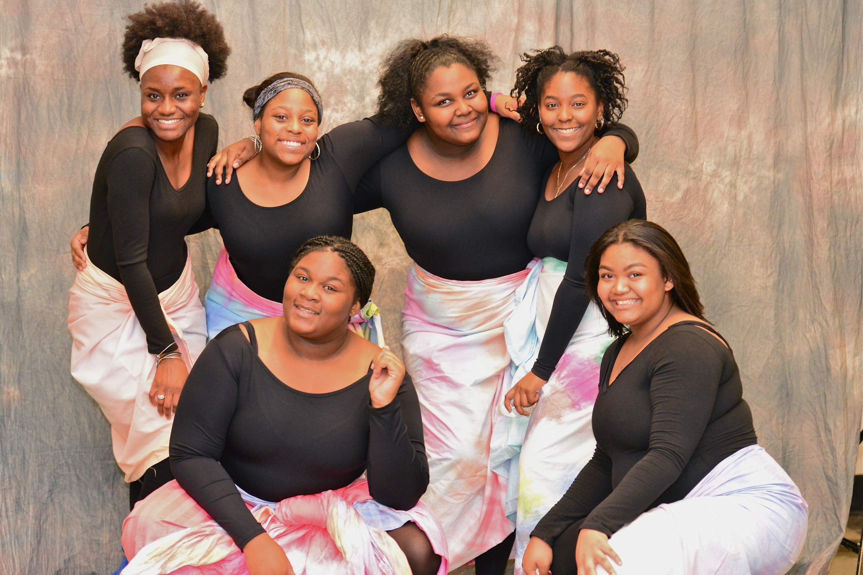

Slide 27
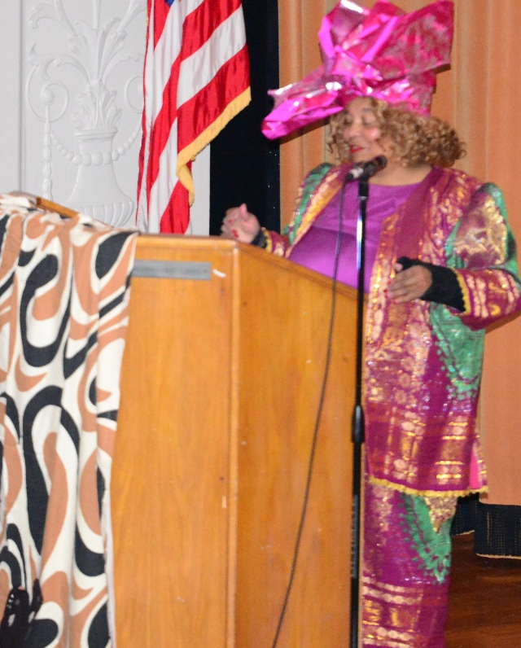
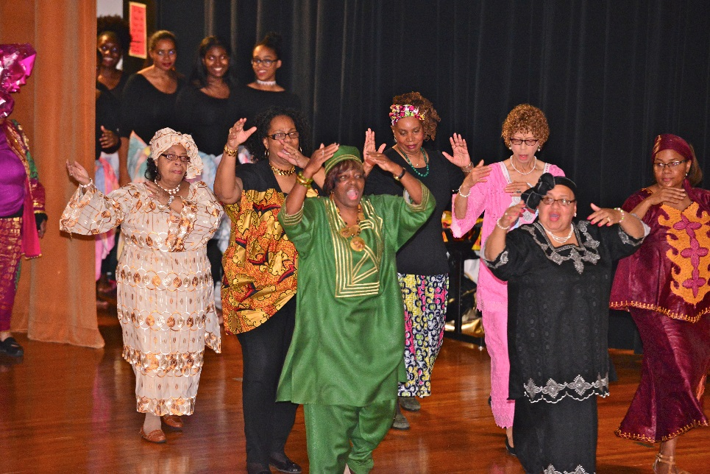

Slide 28
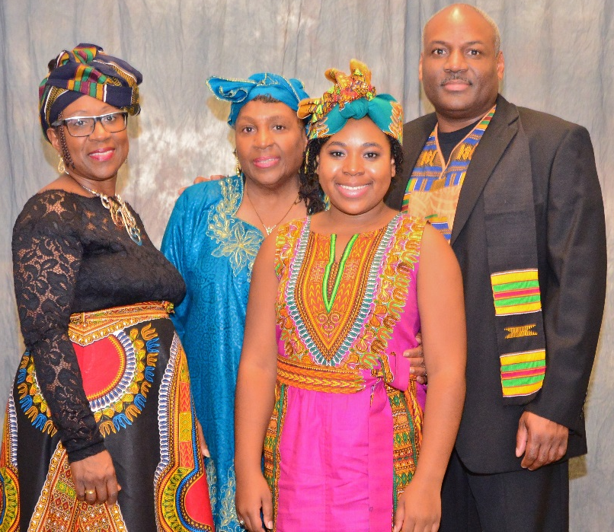
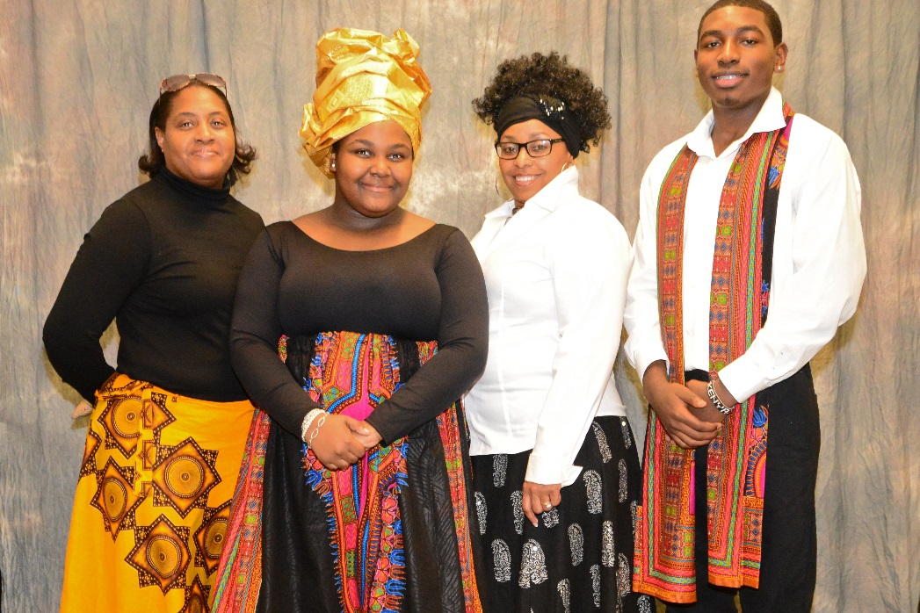
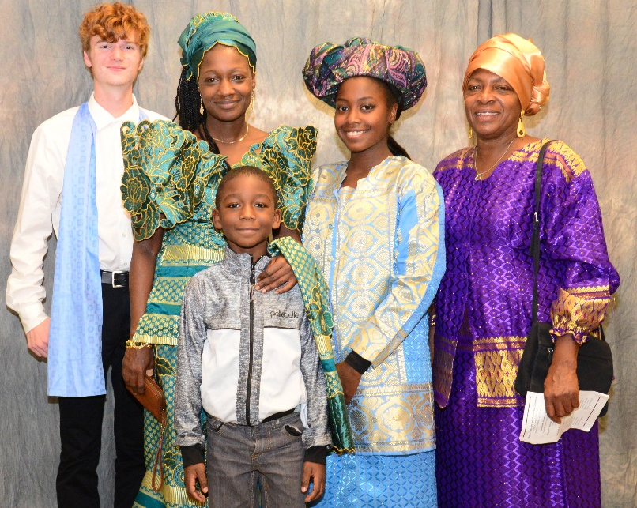
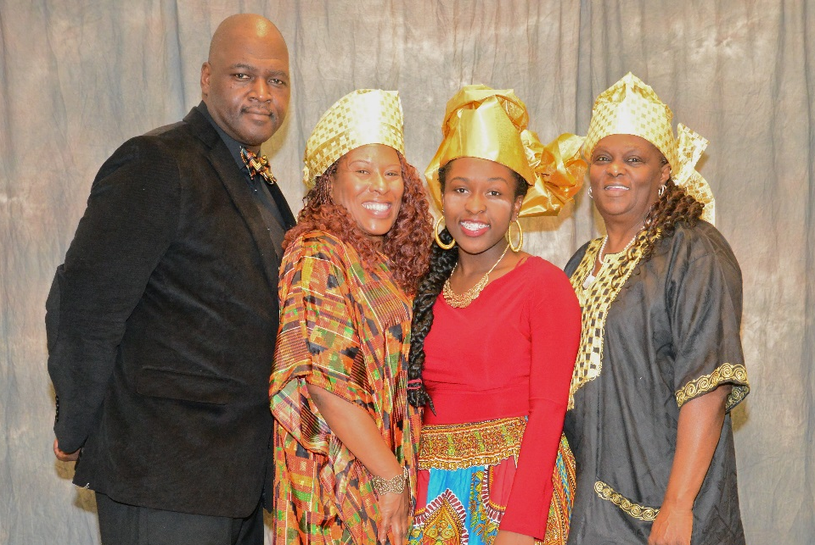

Slide 29
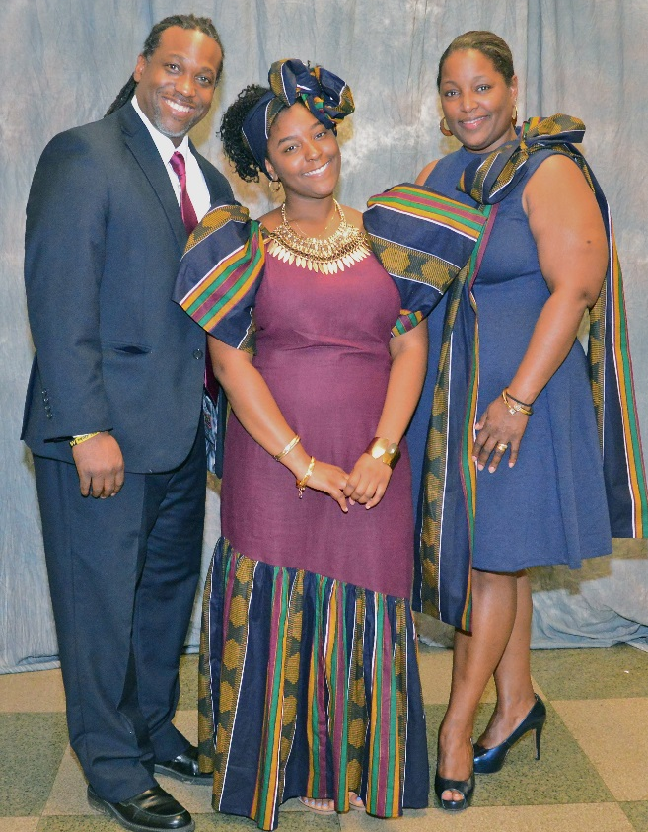
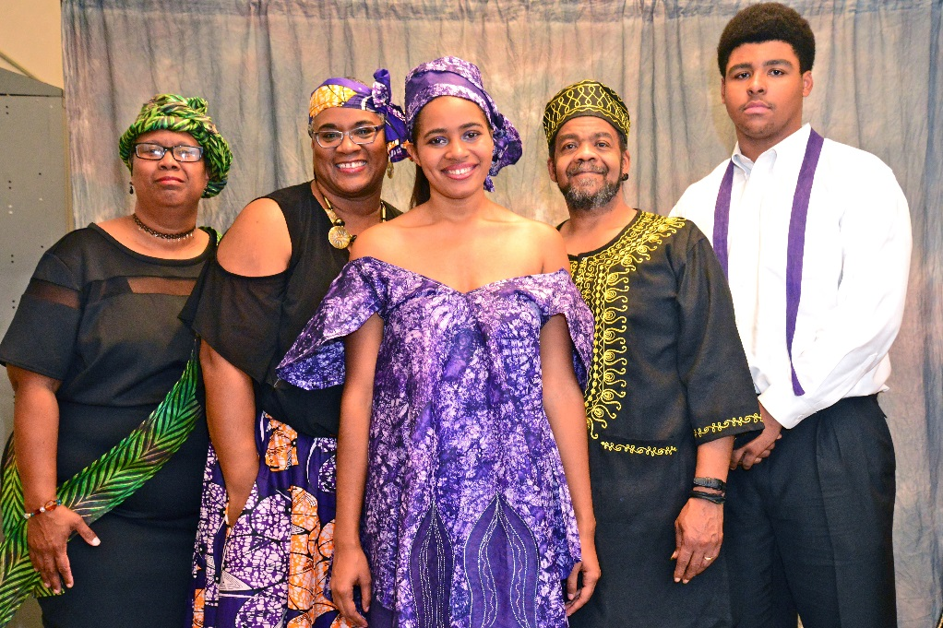
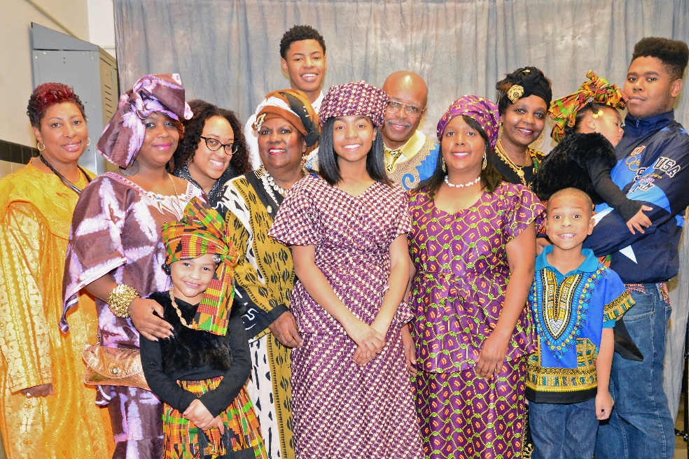

Slide 30
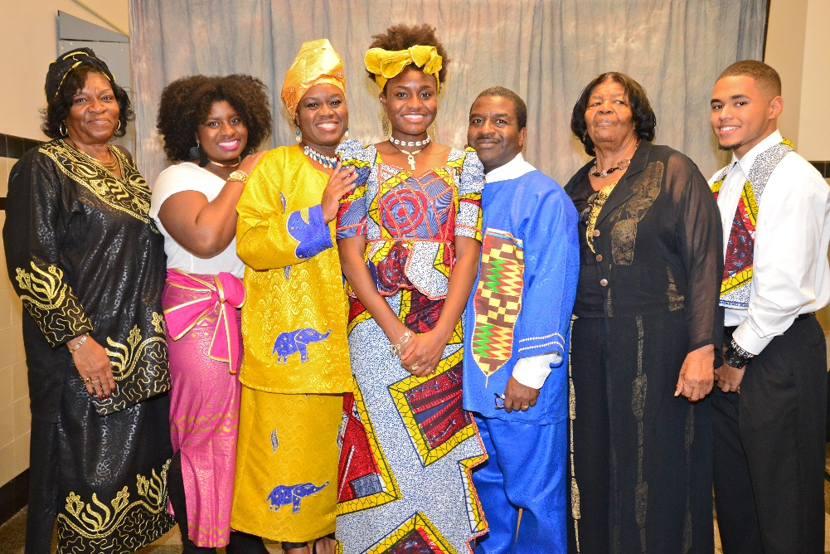
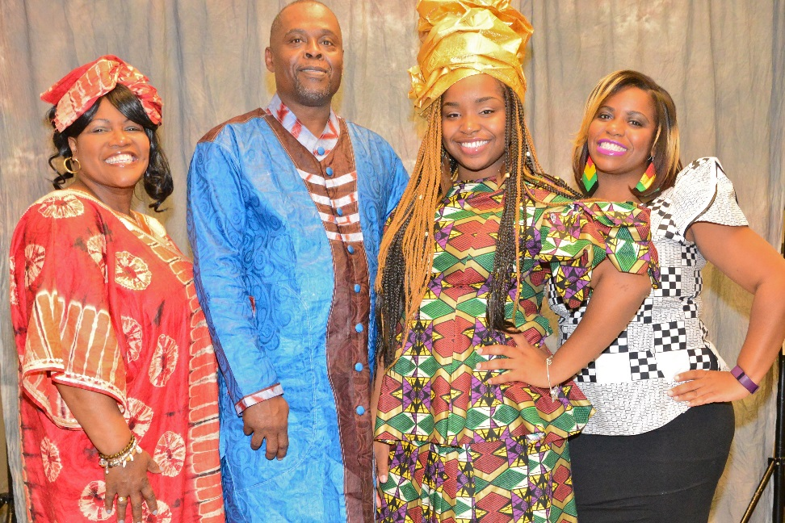
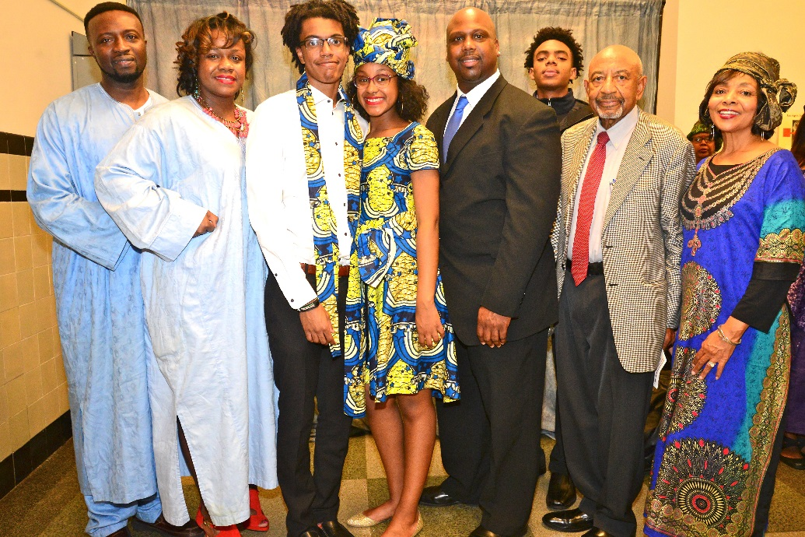
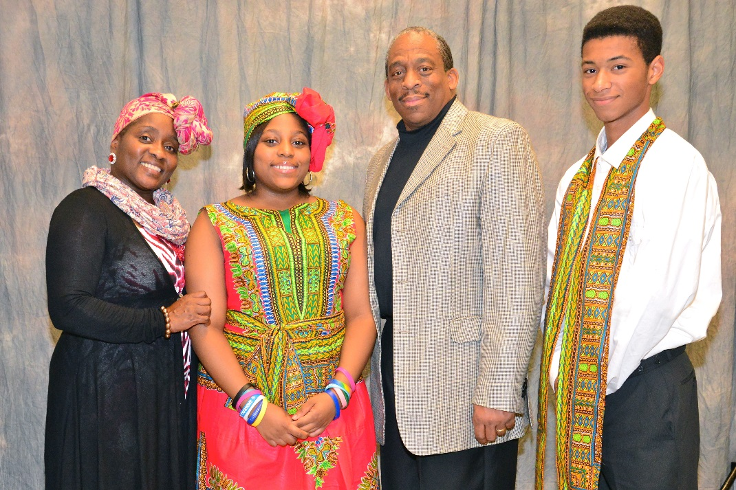

Slide 31
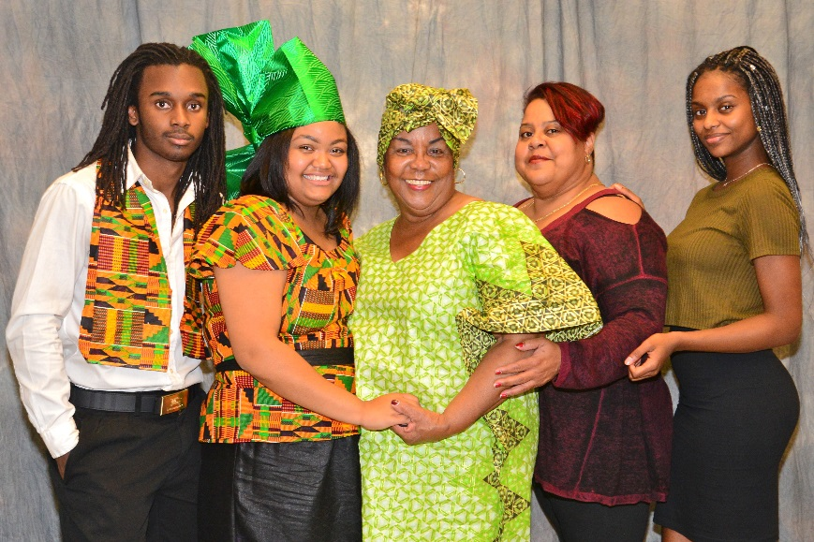

Slide 32
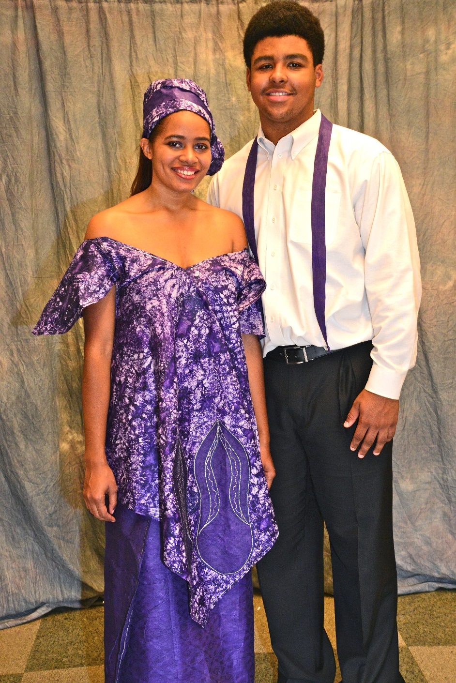
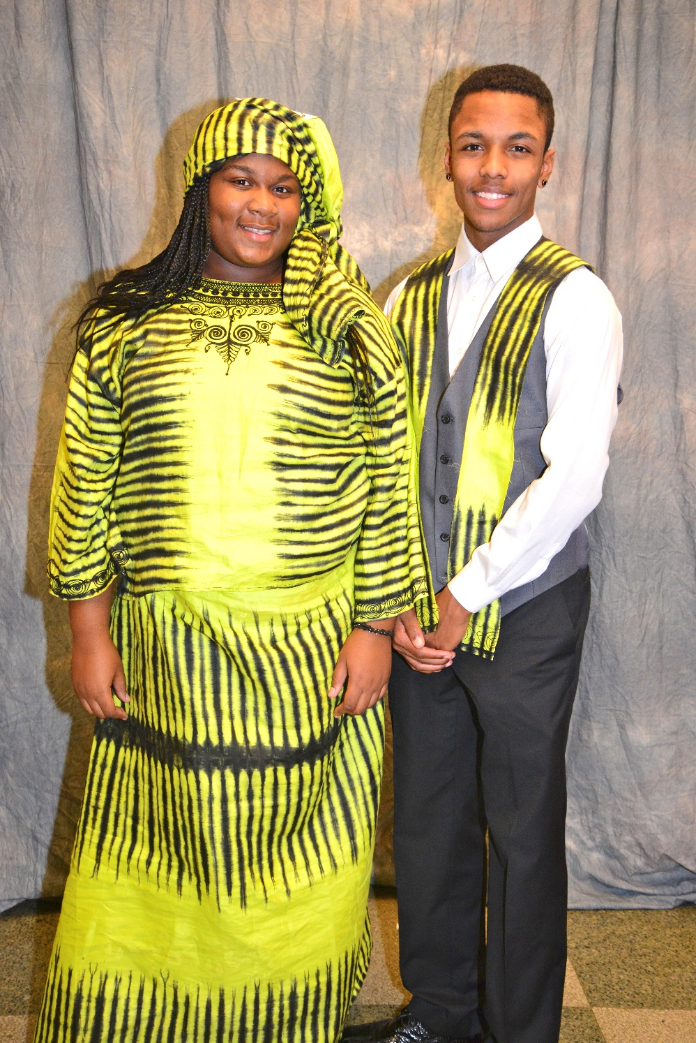
Nyasia Antoneek Wilson and Mickel Woodruff
T’Najah Meeks and
Alonzo Rodriquez-Spencer

Slide 33
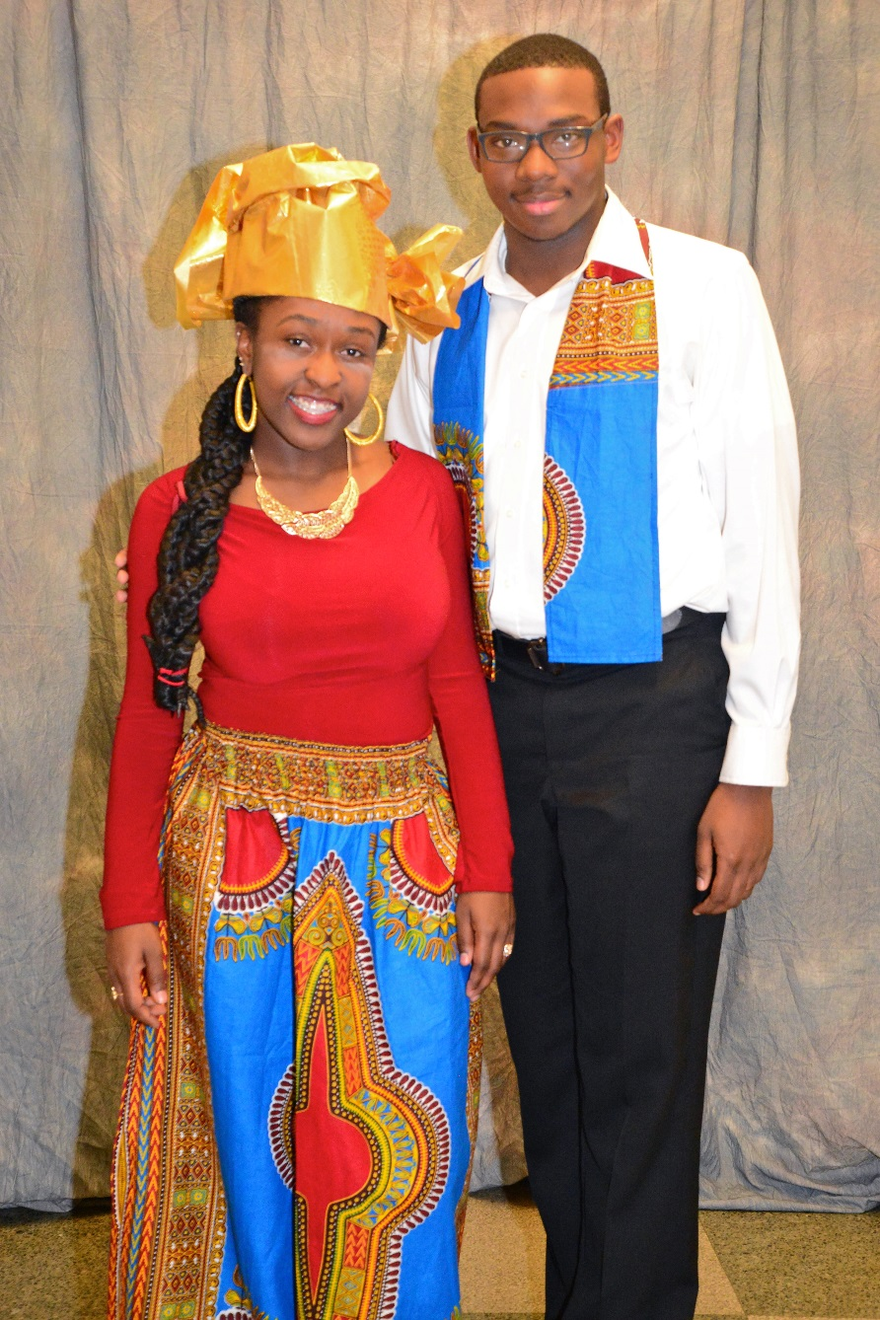
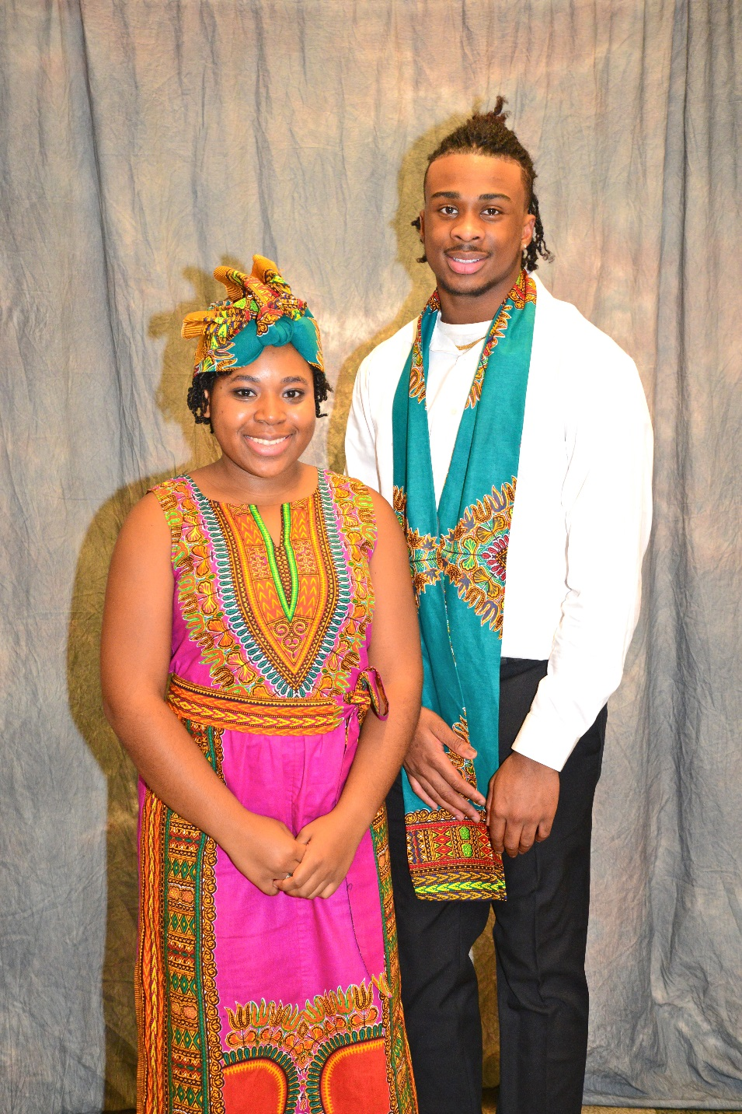
Gabrielle Outling and
Admad Randall
Janelle Benton and
Devin Ford

Slide 34
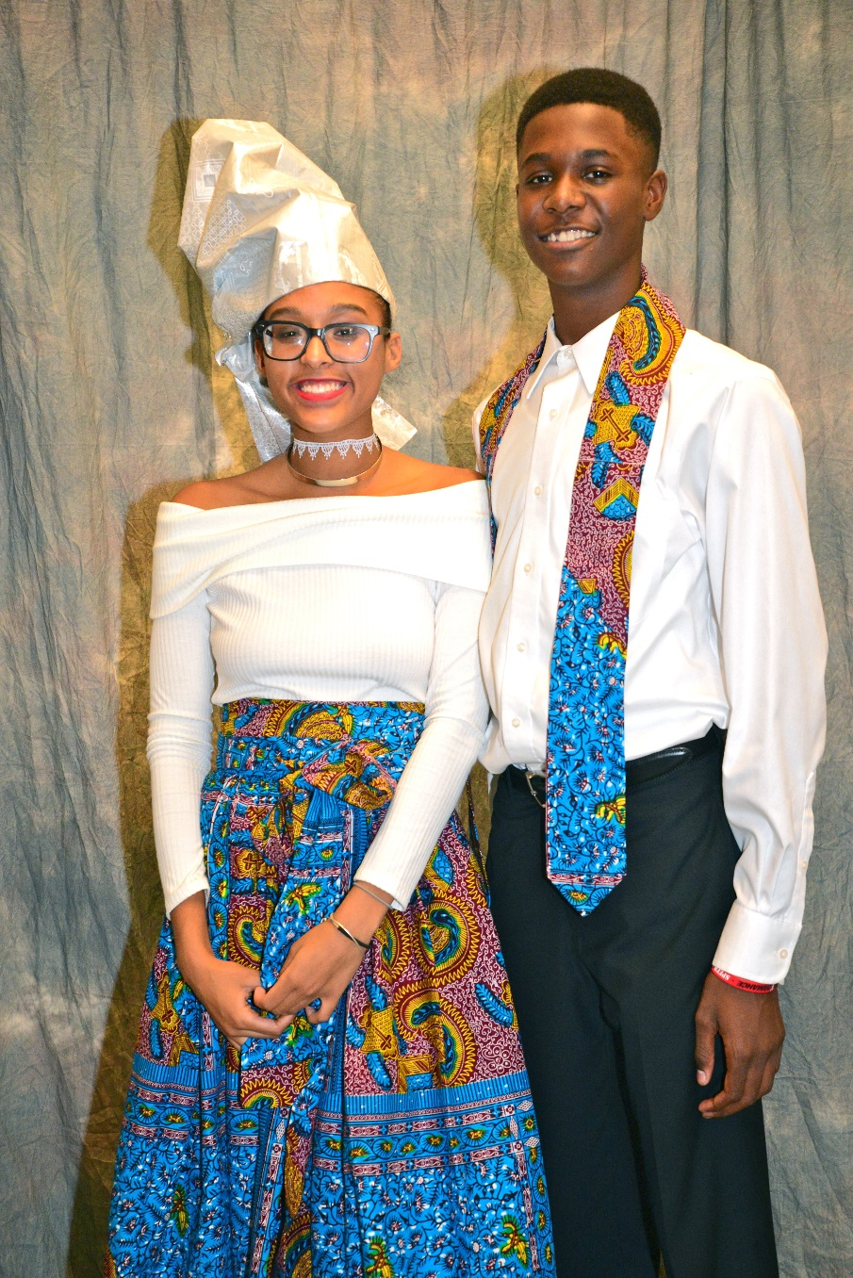
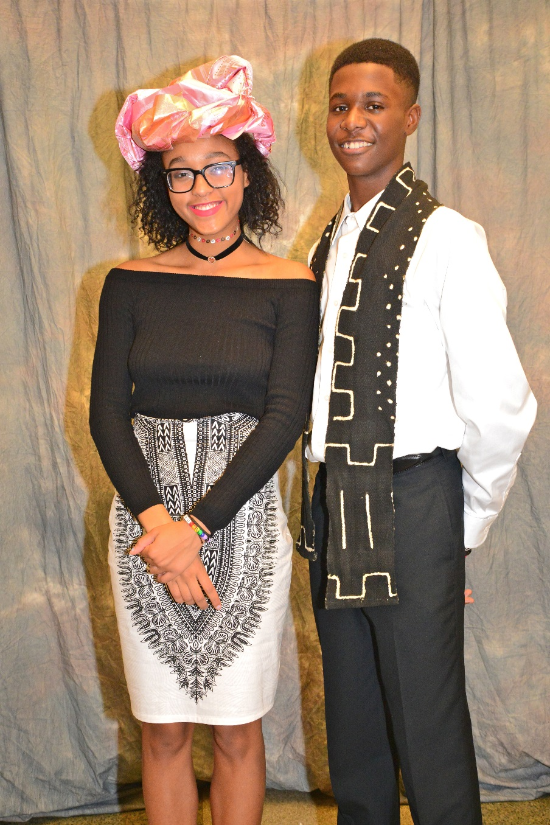
Nia Ellis and
Justin Evans
Kai Ellis
Keith Norward

Slide 35
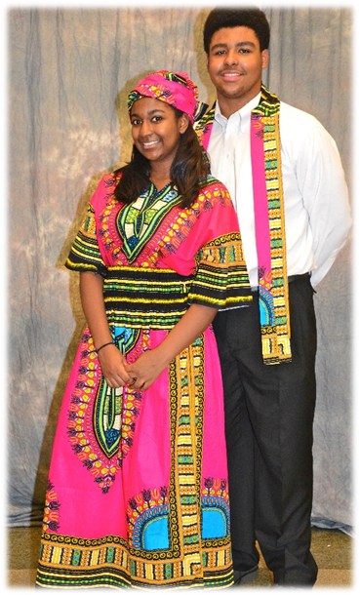
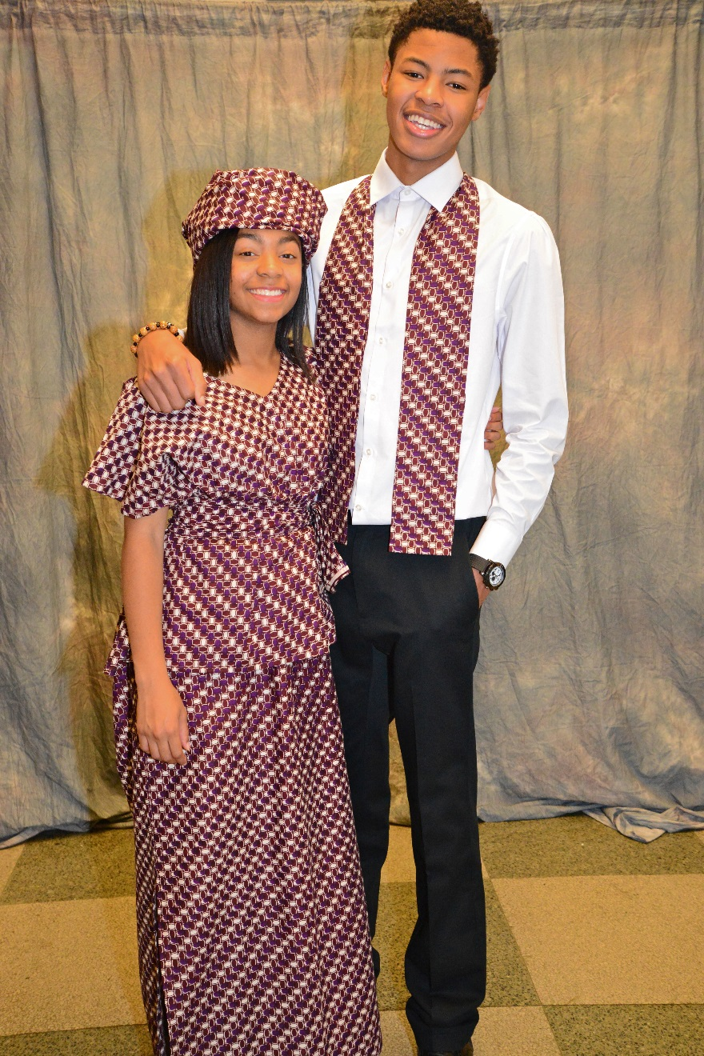
Iyanna Coleman and
Mickel Woodruff
Courtney Harris and
Davon Hardy

Slide 36
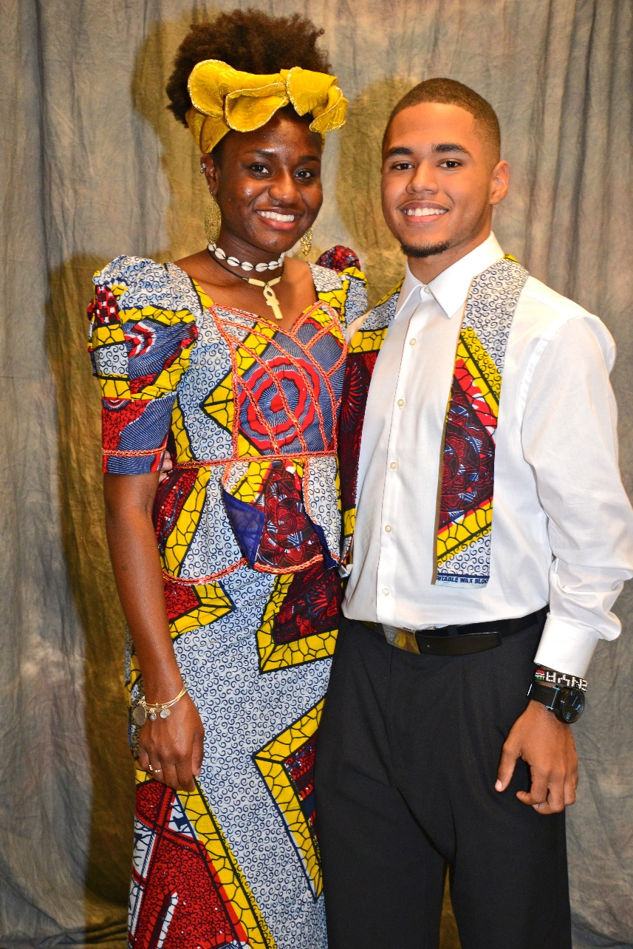
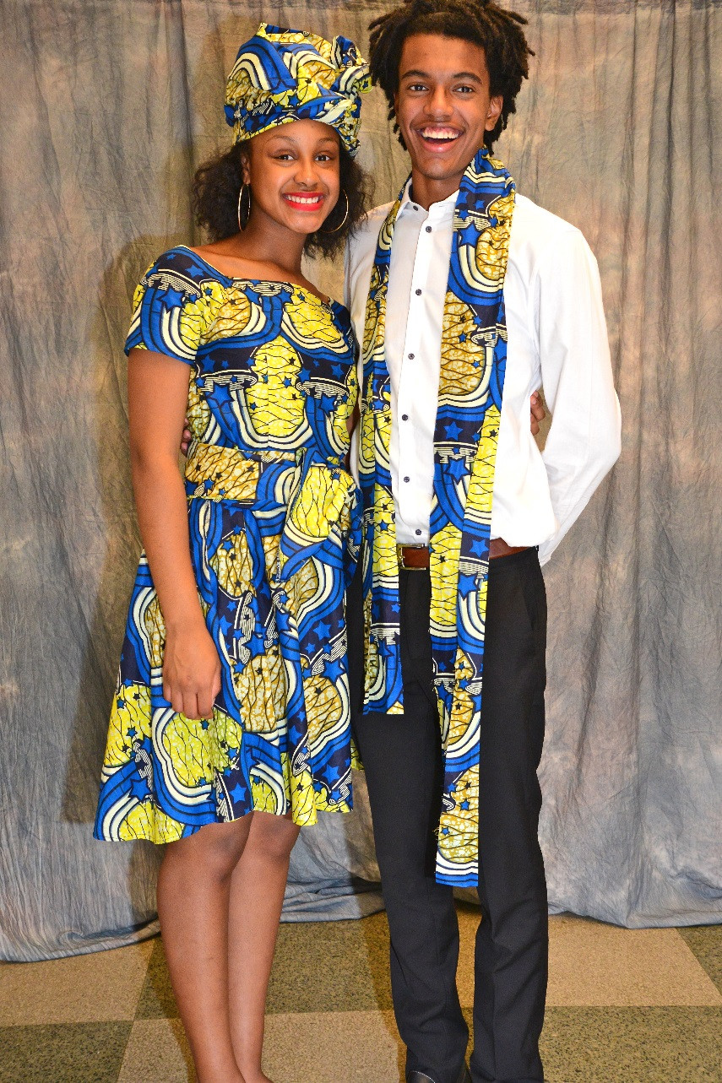
Daneva Moncrieffe and
Jonathan Figueroa
Kennedy McGriff and
Joshua Brooks

Slide 37
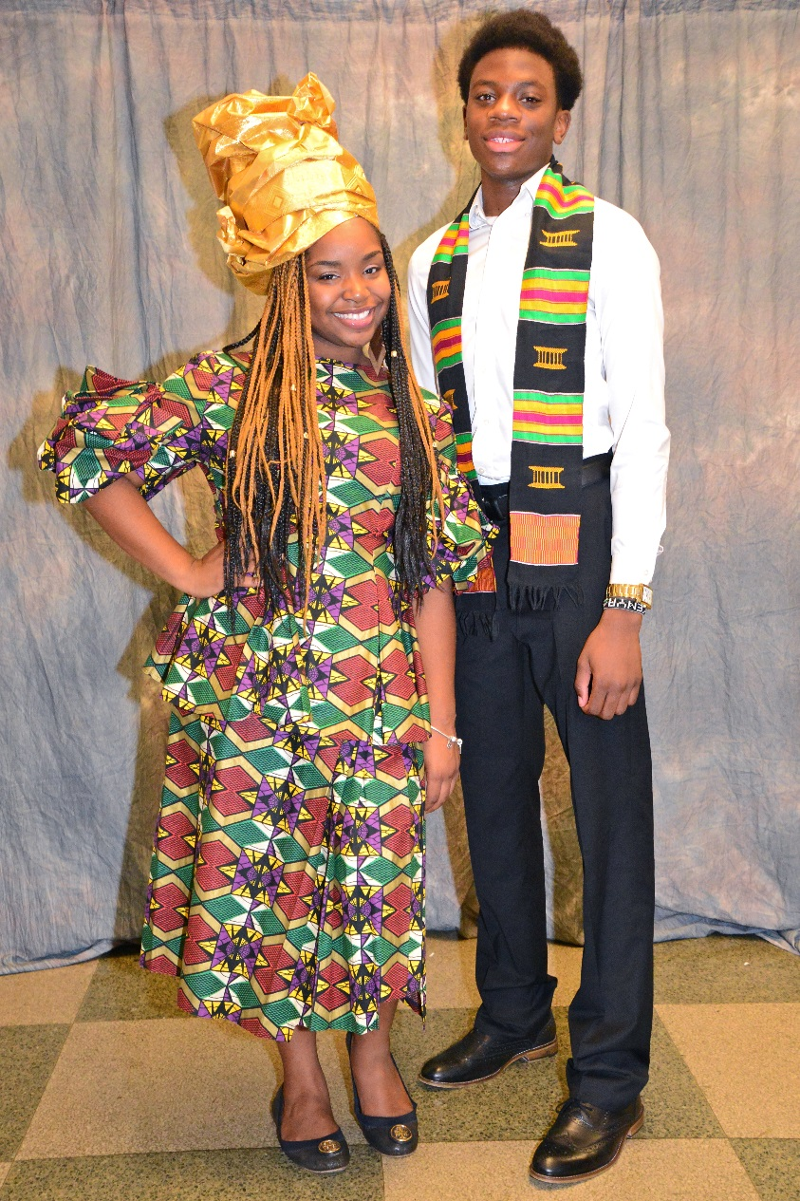
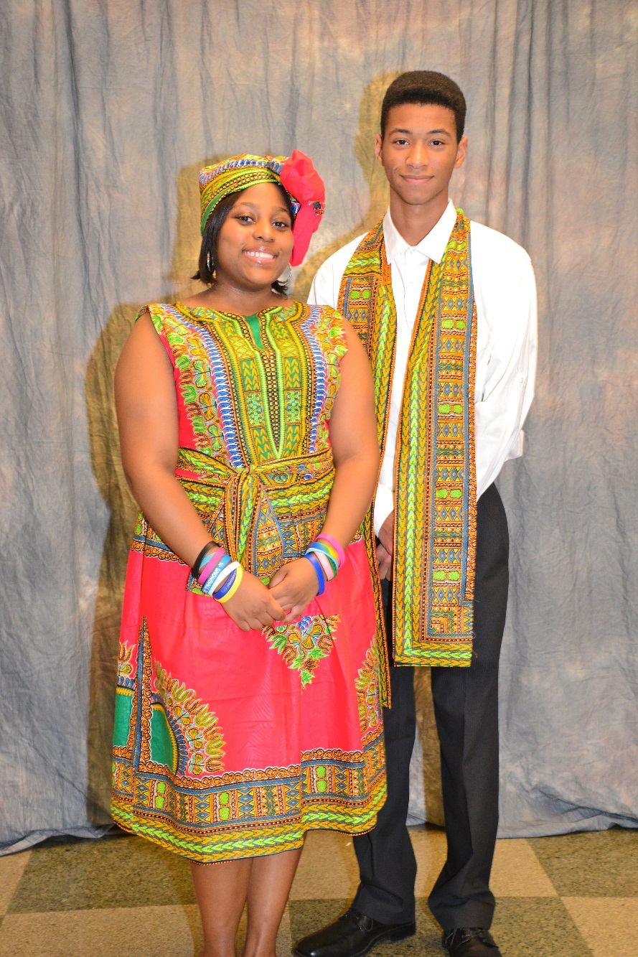
Dayonna Johnson and
Emmanuel Trueheart
Danielle Lewis and
Devin Garey

Slide 38
Lilithann Thompson and
Xavier Kyle
Ahmari Jenkins and
John Chiarello

Slide 39
Leah Madelyn Price and
Marquel Hampshsire
Jensen Daniels and
Anthony Williams

Slide 41
Debutante Pageant & Ball

Slide 42
Iyanna Coleman

Slide 43
Jensen Daniels

Slide 44
Nia Ellis

Slide 45
Kai Ellis

Slide 46
Nyasia Antoneek

Slide 47
Gabrielle Outling

Slide 48
Kennedy McGriff

Slide 49
Daneva Moncrieffe

Slide 50
Lilithann Thompson

Slide 51
Courtney Harris

Slide 52
Danielle Lewis

Slide 53
T’Najah Meeks

Slide 54
Ahmari Jenkins

Slide 55
Janelle Benton

Slide 56
Dayonna Johnson

Slide 57
Leah Madelyn Price

Slide 58
Dayonna Johnson and
Emmanuel Trueheart
Ahmari Jenkins and
John Chiarello

Slide 59
Courtney Harris and
Davon Hardy
Jensen Daniels and
Anthony Williams

Slide 60
Nia Ellis and
Justin Evans
Kai Ellis
Keith Norward

Slide 61
Iyanna Coleman and
Brandon Barksdale
Janelle Benton and
Devin Ford

Slide 62
Danielle Lewis and
Devin Garey
Kennedy McGriff and
Joshua Brooks

Slide 63
Nyasia Antoneek Wilson and Mickel Woodruff
T’Najah Meeks and
Alonzo Rodriquez-Spencer

Slide 64
Daneva Moncrieffe and
Jonathan Figueroa
Gabrielle Outling and
Admad Randall

Slide 65
Lilithann Thompson and
Xavier Kyle
Leah Madelyn Price and
Marquel Hampshsire

Slide 74
Gamma Phi Omega Executive Board

Slide 75
Gamma Phi Omega Golden Sisters

Slide 76
Debutante Tea

Slide 101
Debutante
Rites of Passage Dinner

Slide 106
Debutante
Father & Daughter Cook-Off

Slide 111
Debutante Activities

Slide 117
Congratulations to our
2016 Debutantes

